Slide 1
Self Organized Criticality: Fluvial landscapes
Willem Hekman &
Daan Kuitenbrouwer

Slide 2
Content
Recap of Self Organized Criticality (SOC)
Idea of SOC in landscapes
Pseudo code
Results
Discussion

Slide 3
Recap SOC
Dynamical systems
Simple set of rules (cellular automaton)
Go to critical point (without specific control parameters)
Occurs for different length and time scale
→ complex structures

Slide 4
SOC in landscapes
Rivers erode valleys
Different length scales

Slide 5
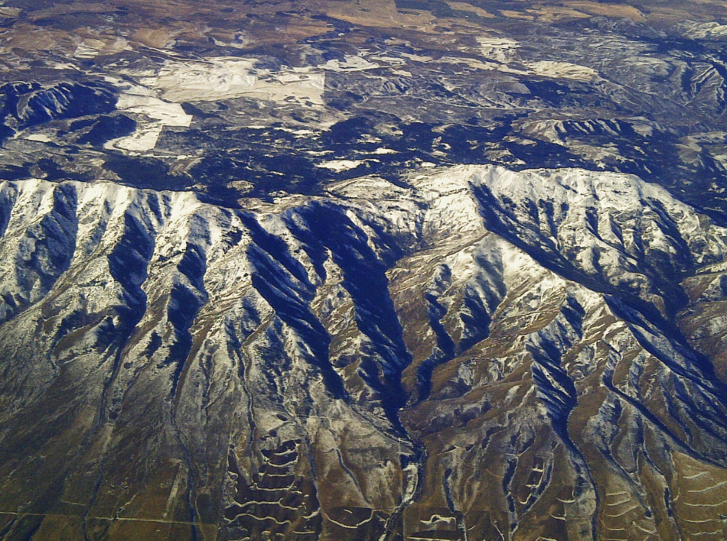

Slide 6
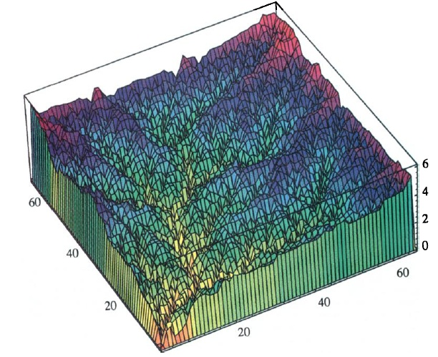
Rigon et al. (1994)

Slide 7
Pseudo code
According to Caldarelli. (1996)
Loop over:
calculate shear stress (t) at each gridpoint
If t > tc:
erode so t = tc
if all t < tc:
add perturbation

Slide 8
Calculate shear stress

Slide 9
Problems with this implementation
No canyons created

Slide 10
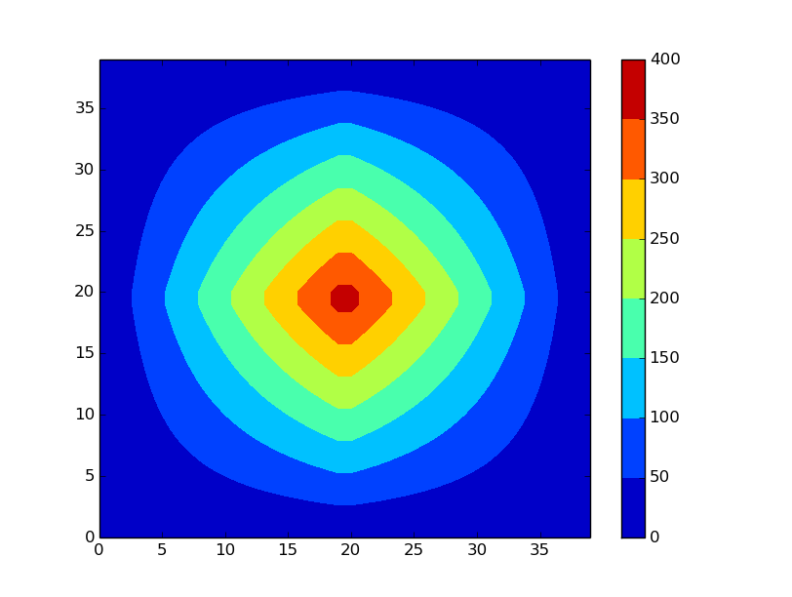

Slide 11
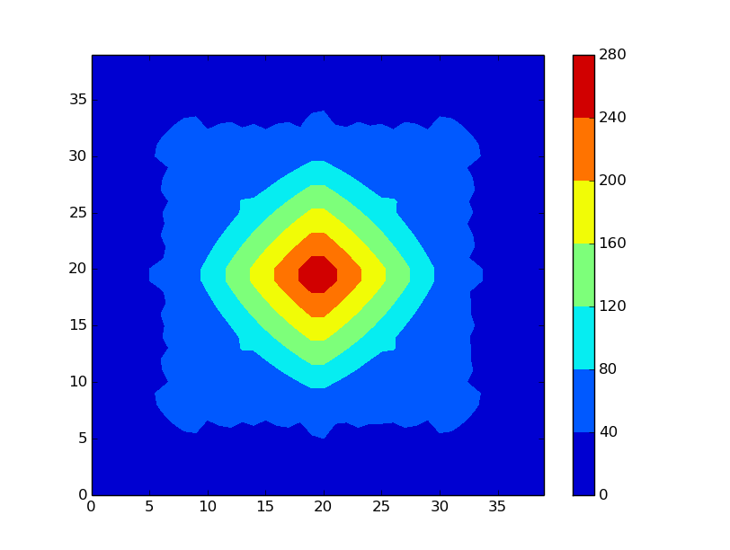

Slide 12
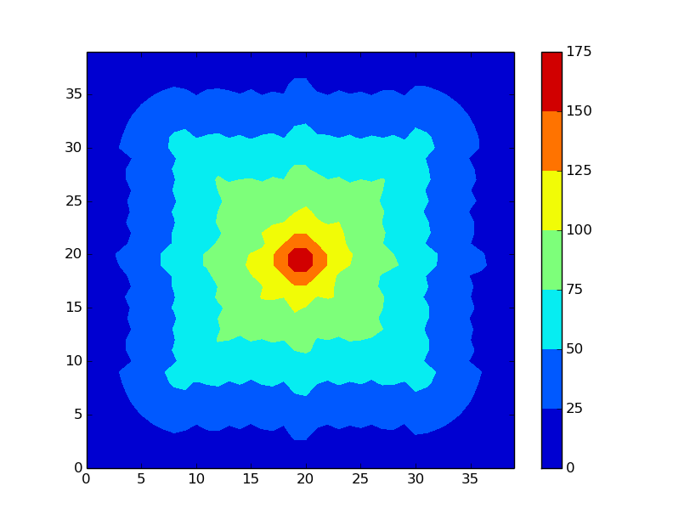

Slide 13
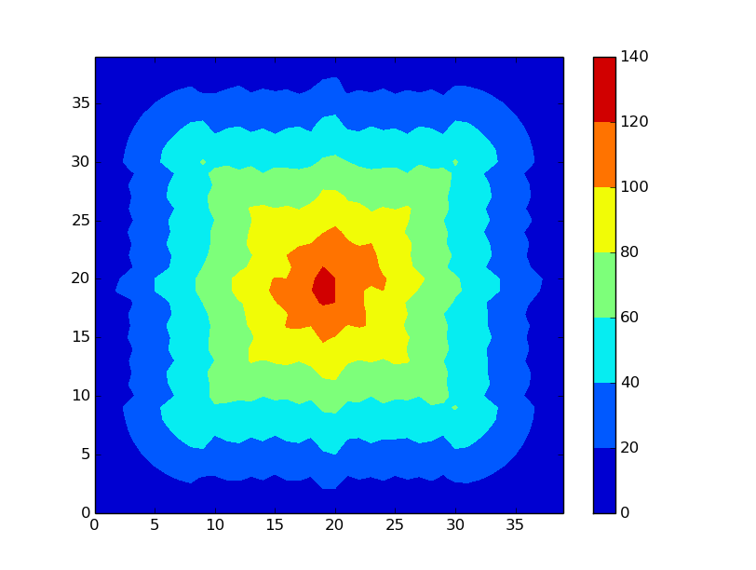

Slide 15
Another approach
According to Rigon et al. (1994)
Instead of decreasing height at all positions where , only decrease height at position with heighest shear stress.

Slide 16
Results

Slide 17
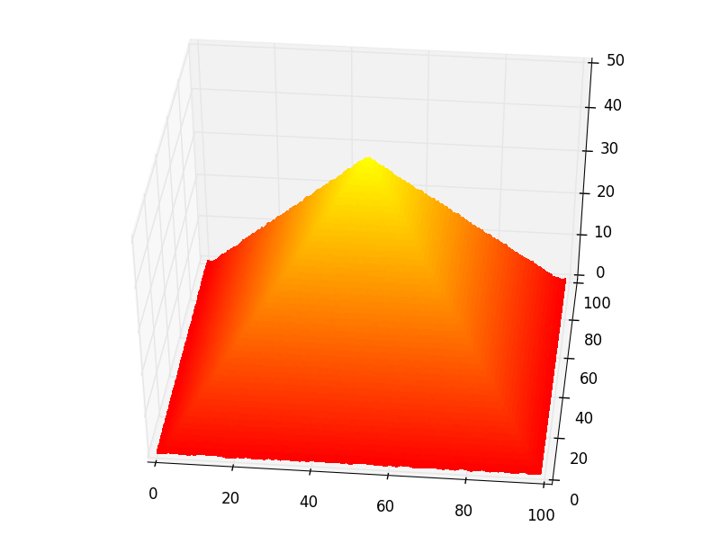

Slide 18
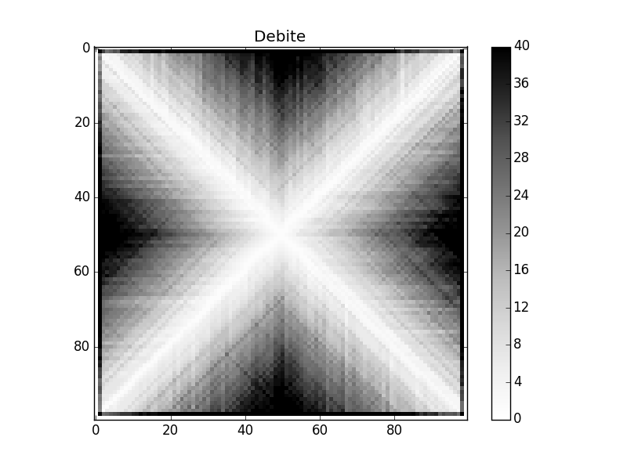

Slide 19
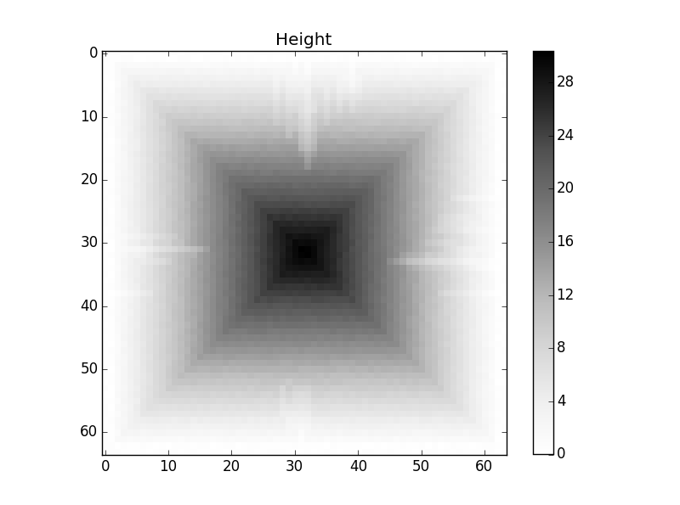

Slide 20
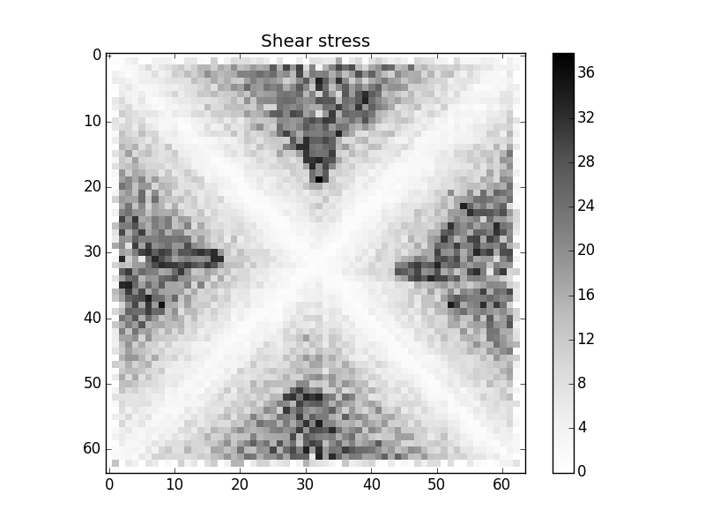

Slide 21
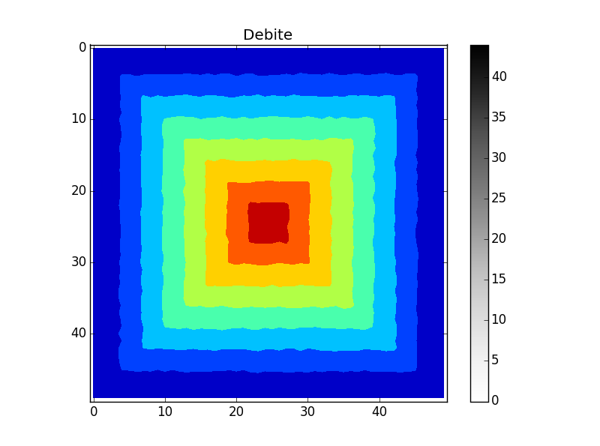

Slide 22
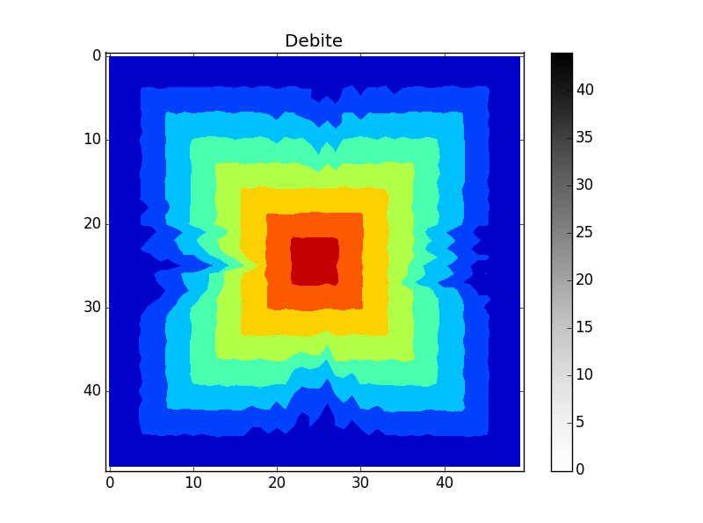

Slide 23
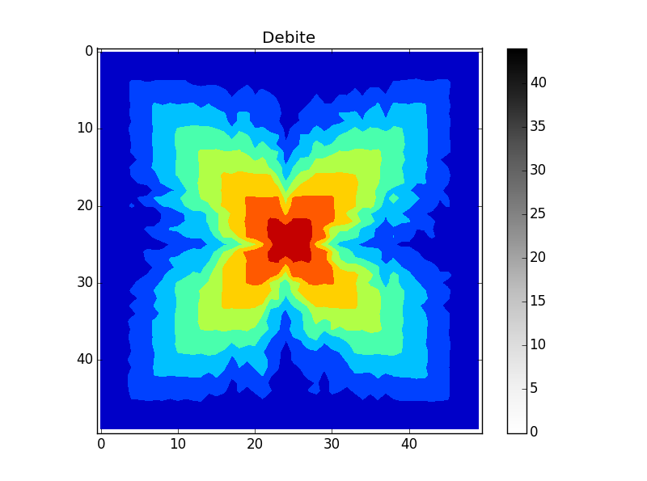

Slide 24
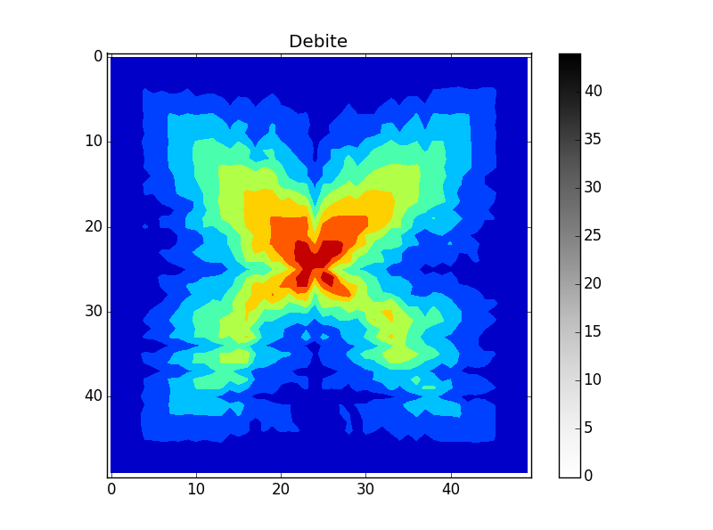

Slide 25
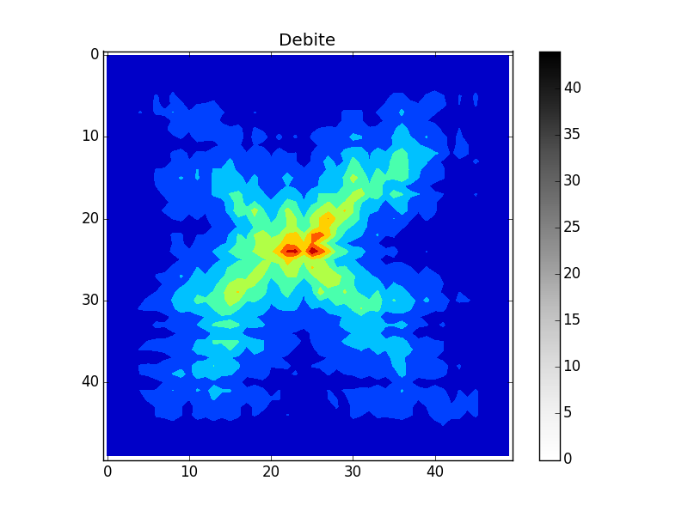

Slide 26
Discussion
Hard to reproduce results with Caldarelli method, no formation of canyons.
Behaviour very dependent on
→ stresses SOC

